Slide 1

G H Raisoni College of Engineering, Nagpur
Date : 24th October 2020
Department of Computer Science and Engineering
Project Phase –I Title Finalization Seminar
Session: 2020-2021
Presented By:
VII_C_13(Nihal Arkhel)
VII_C_22(Rahul Yadav)
VII_C_23(Rajat Harinkhede)
VII_C_24(Ritik Walgaonkar)
Presented to:-
Prof.Pranay Saraf Assistance Professor
GHRCE ,Nagpur

Slide 2
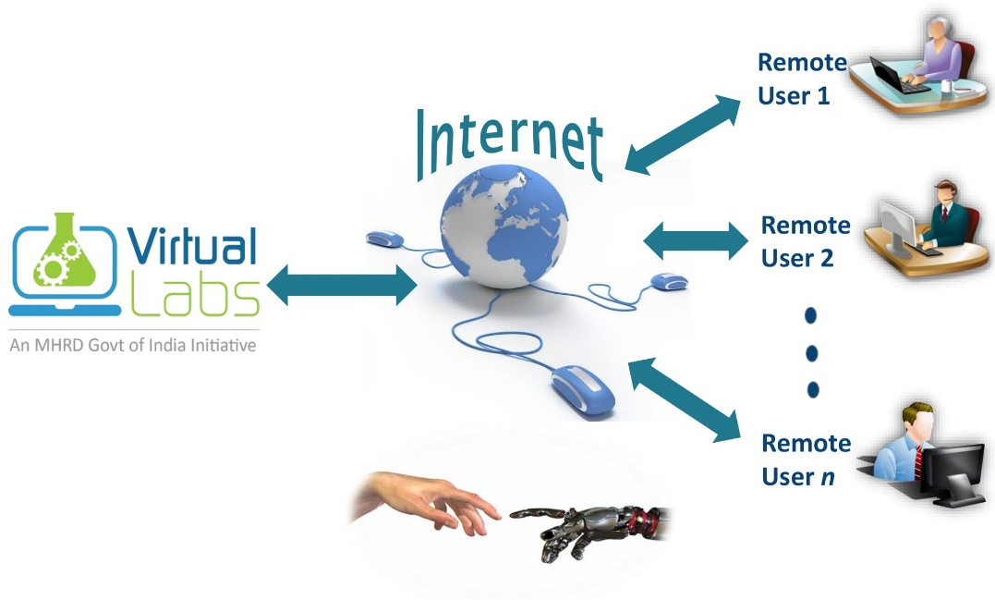
Introduction
What are Virtual Labs?
Virtual Labs project is an initiative of Ministry of Human Resource Development (MHRD), Government of India under the aegis of National Mission on Education through Information and Communication Technology (NMEICT). It is a paradigm shift in ICT-based education. Under Virtual Labs project, over 100 Virtual Labs consisting of approximately 700+ web-enabled experiments were designed for remote-operation and viewing.
The Project solely focuses to make a virtual lab for GHRCE, which currently does not exist. This Virtual lab focuses to consist of all the good features from as many Virtual Labs as possible.

Slide 3
Objectives & Further Possibilities
Different topics with its list of experiments with simulations/videos for better Understanding. User friendly UI & easy to access features.
No additional infrastructural setup for conducting experiments at user premises.
To access the simulations-based experiments remotely via internet.
To help students perform the experiment more than once.
Provide a choice for the Institute to conduct experiments according to their choice.
To provide Students and Faculty Members have access to instruments which we do not own.
To trigger the inquisitiveness of the High‐school students, possibly motivating them to take up higher‐studies in Applied Sciences.

Slide 4
Hardware /Software Specification
. This project belongs to the category of Web Applications as use the Web application will give the feasibility to serve the same virtual lab to multiple students. It is a type of classroom management software or say teaching assistance suite.
. Software used for the project are as following:
. For accessing the labs, the users will require a Personal Computer to work on.
. For simulation related practical's Web Player/Flash Player is required on the Platform.
NODE Js
REACT
Unity / Unreal Engine / Adobe Flash
Js Animation Libraries
Web player (in absence of WebGL Simulation)

Slide 5
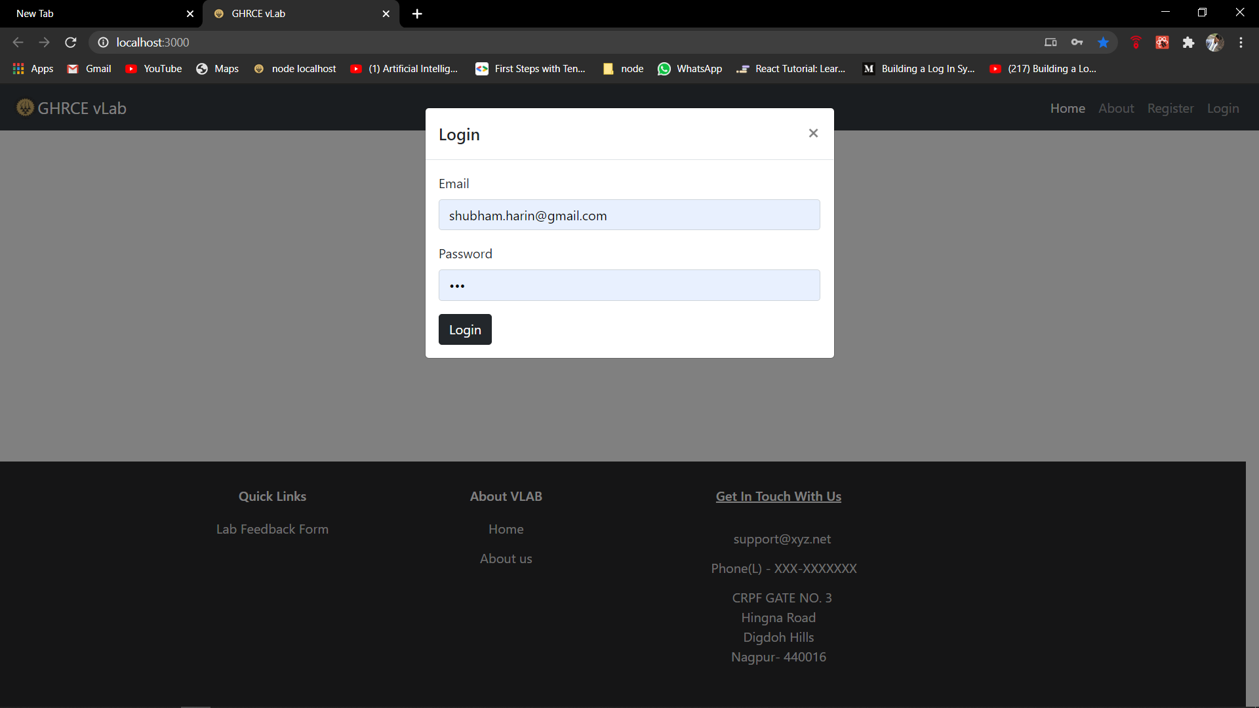
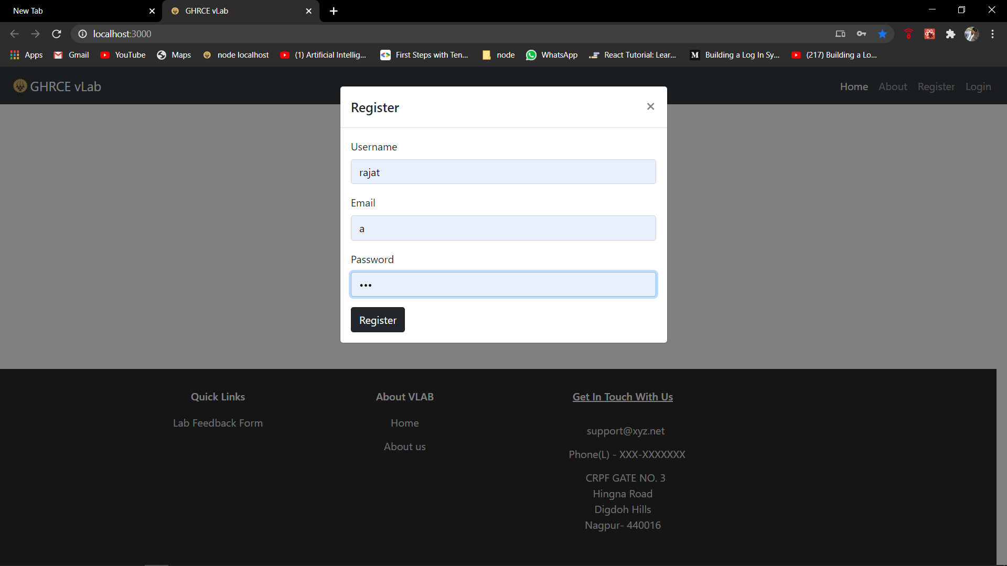
Module Description
. Login page : . Register page
.

Slide 6
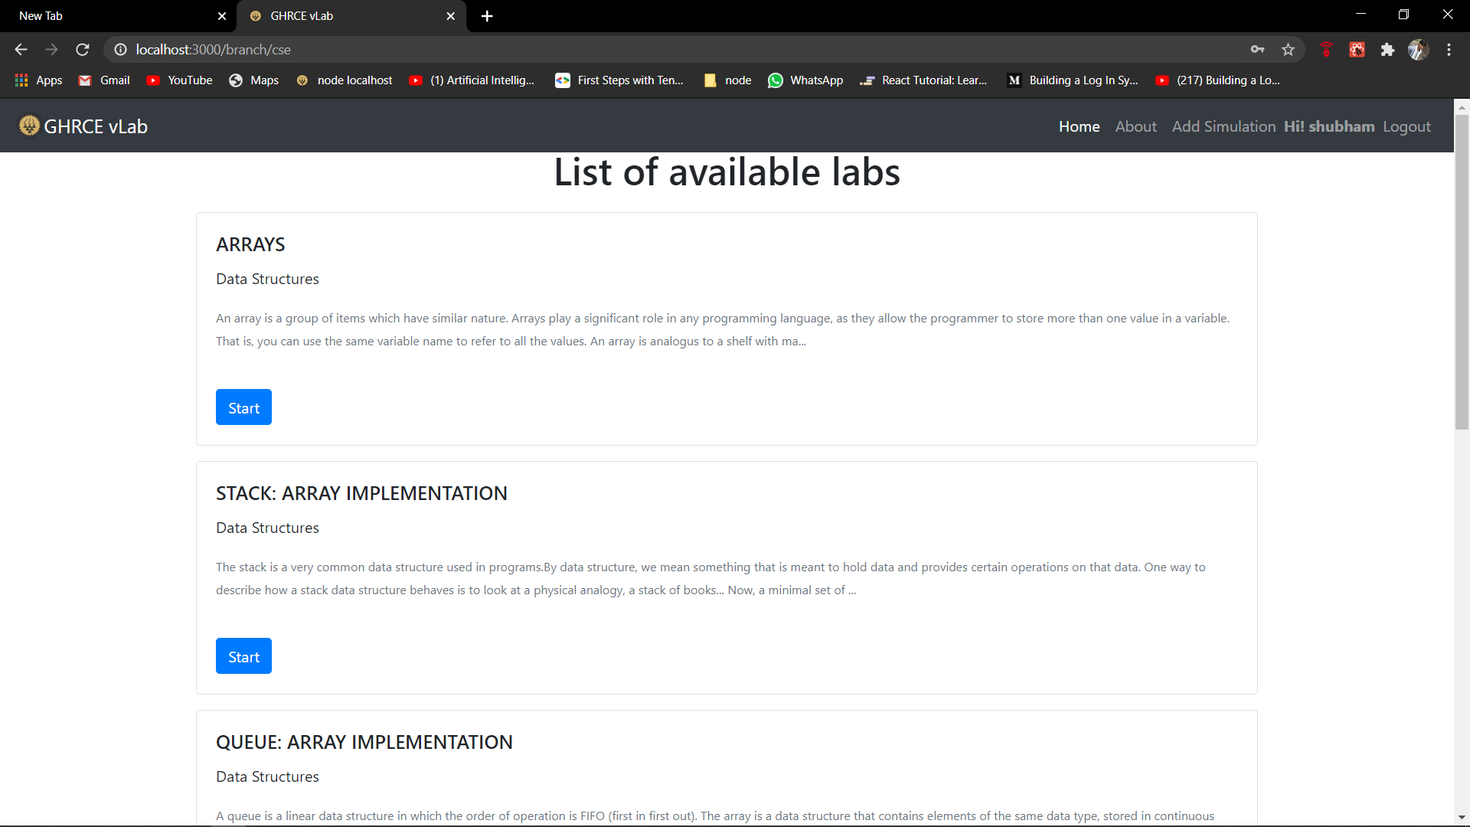
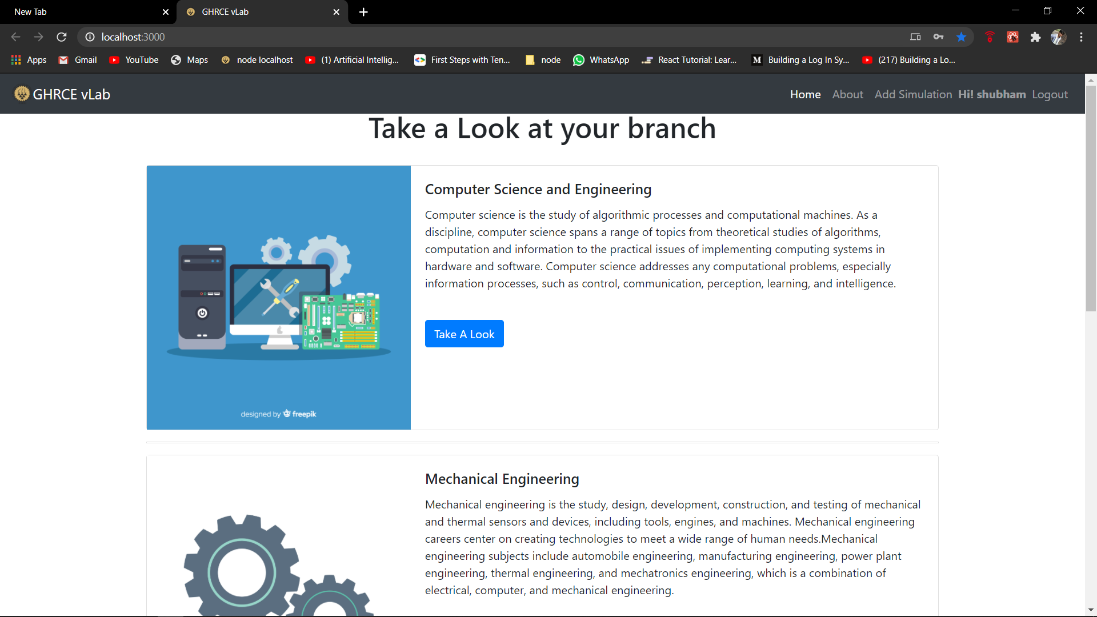
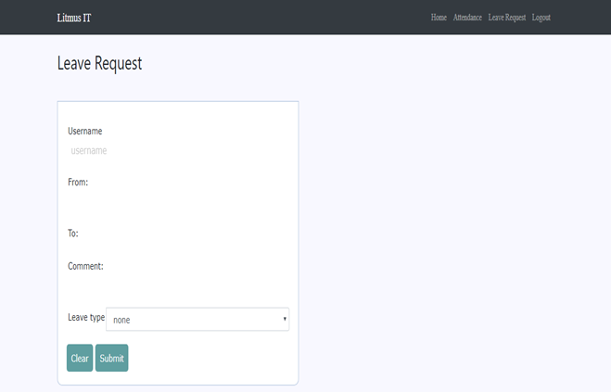
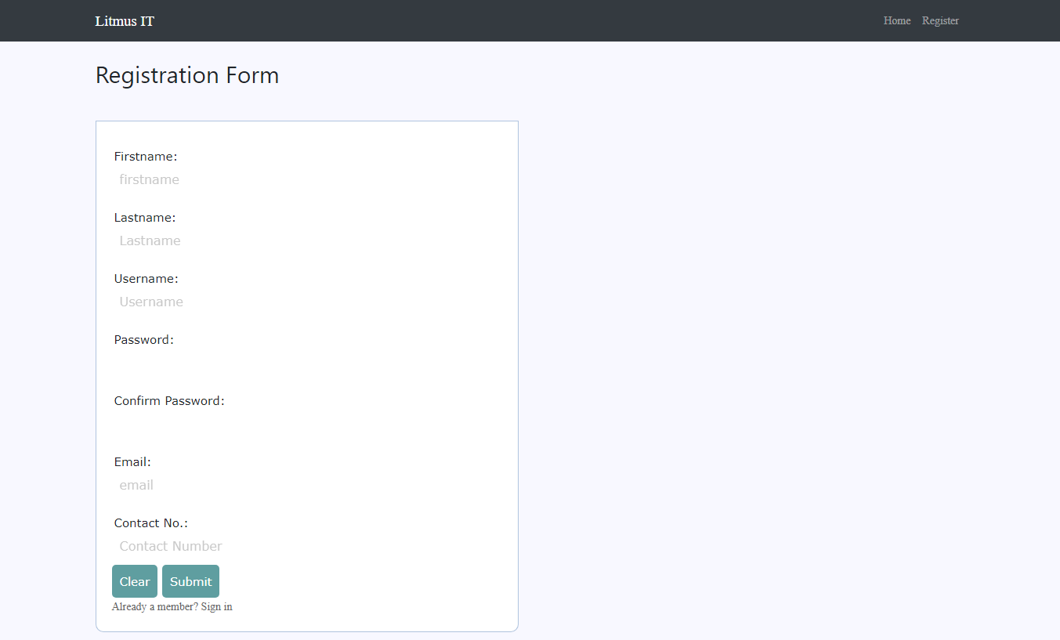
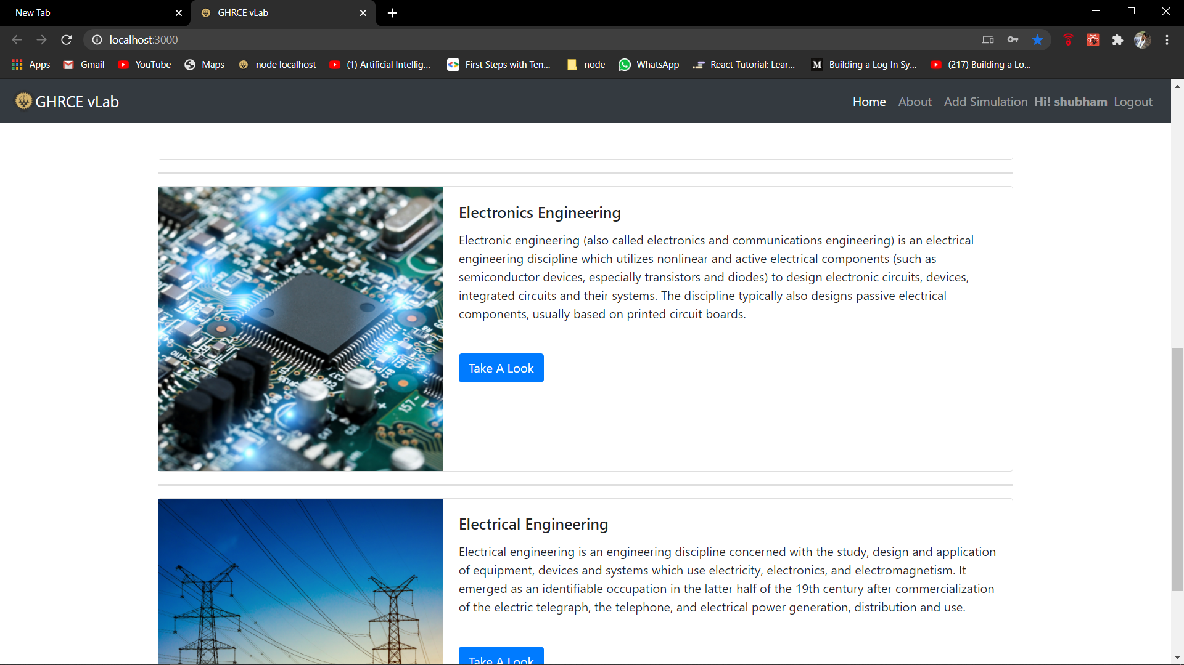
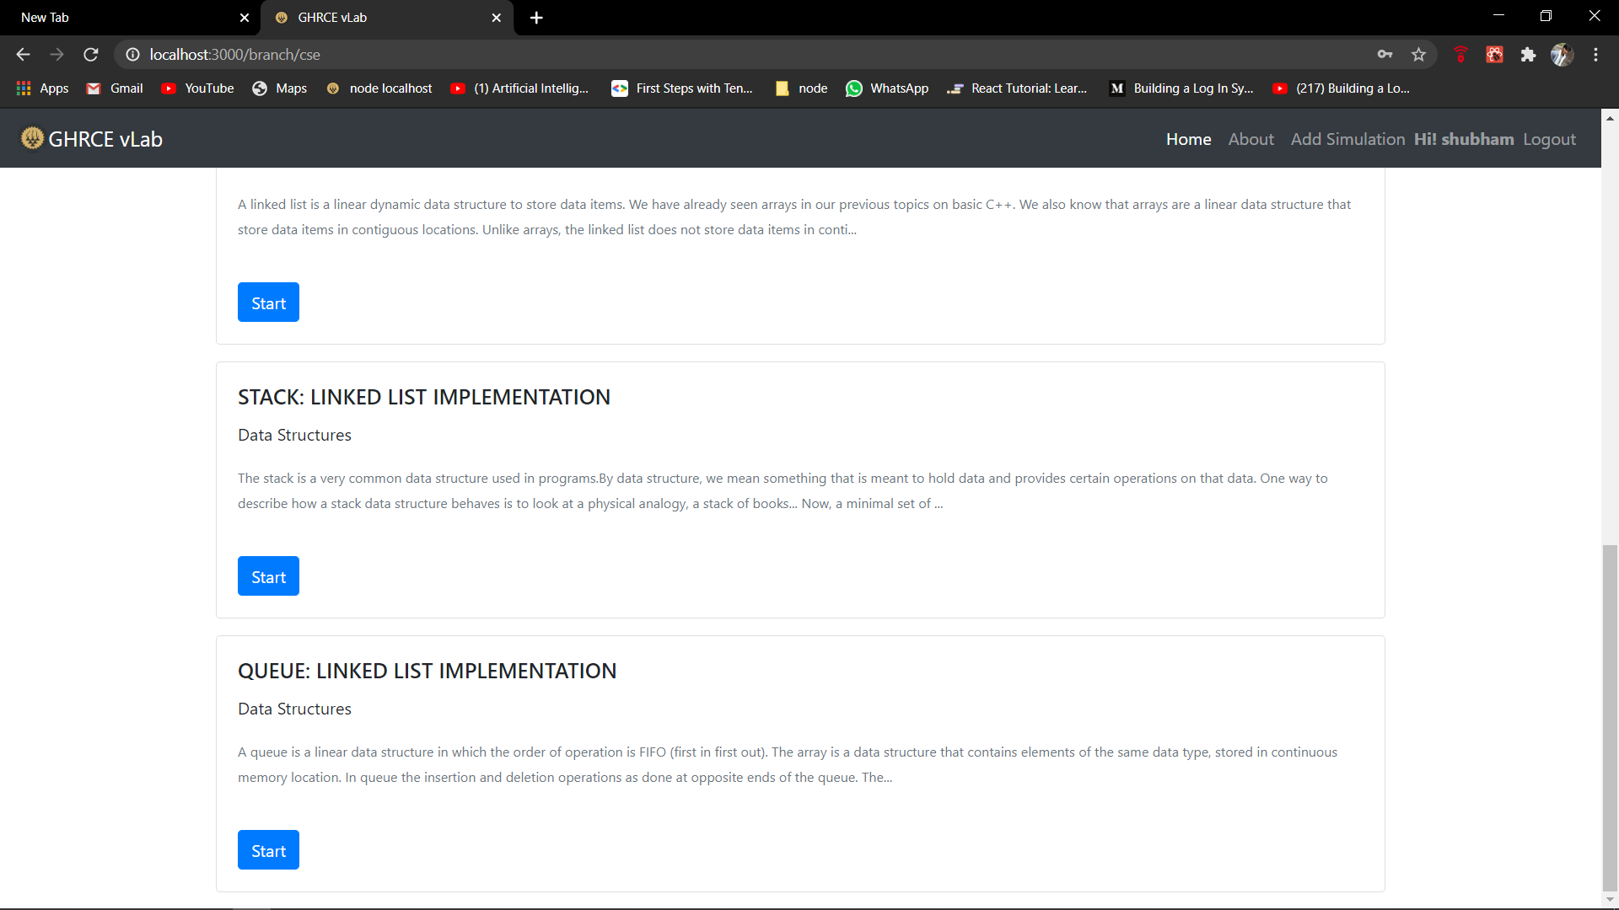
Module Description
Take a look at your branch list :
List of available labs and Experiment list :

Slide 7
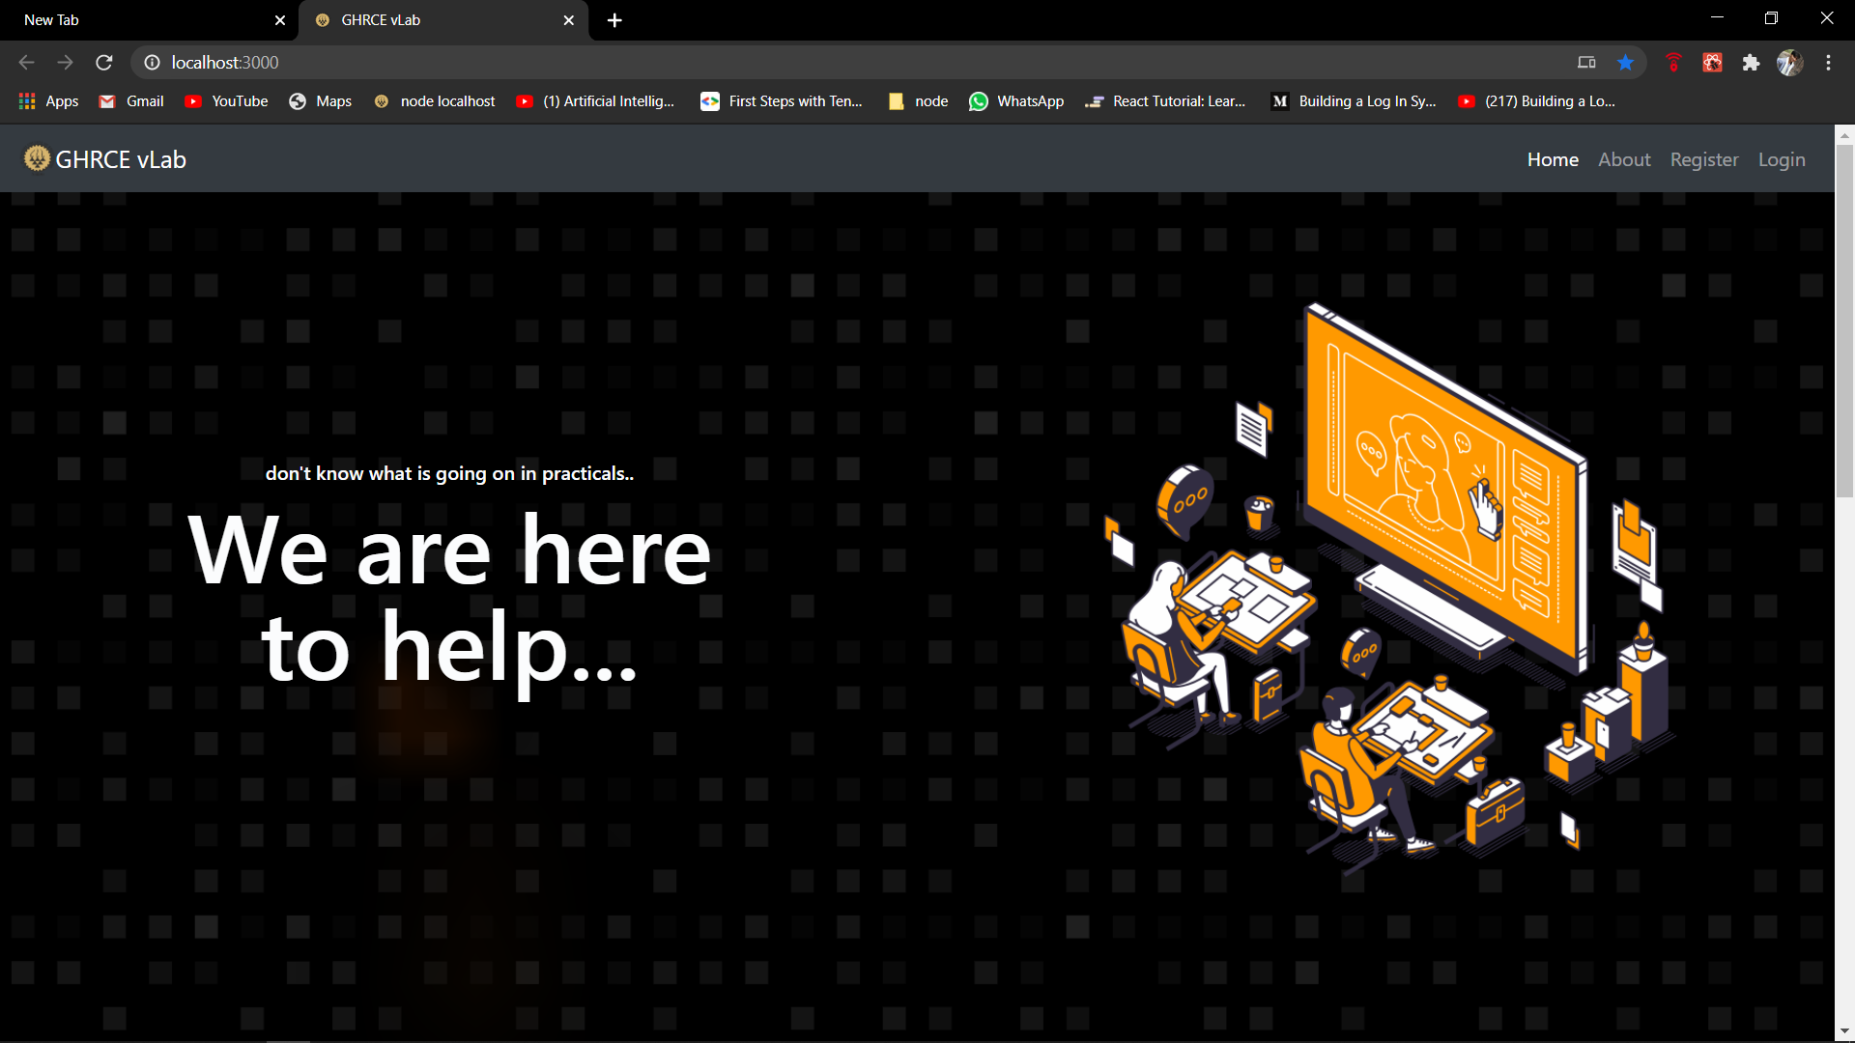
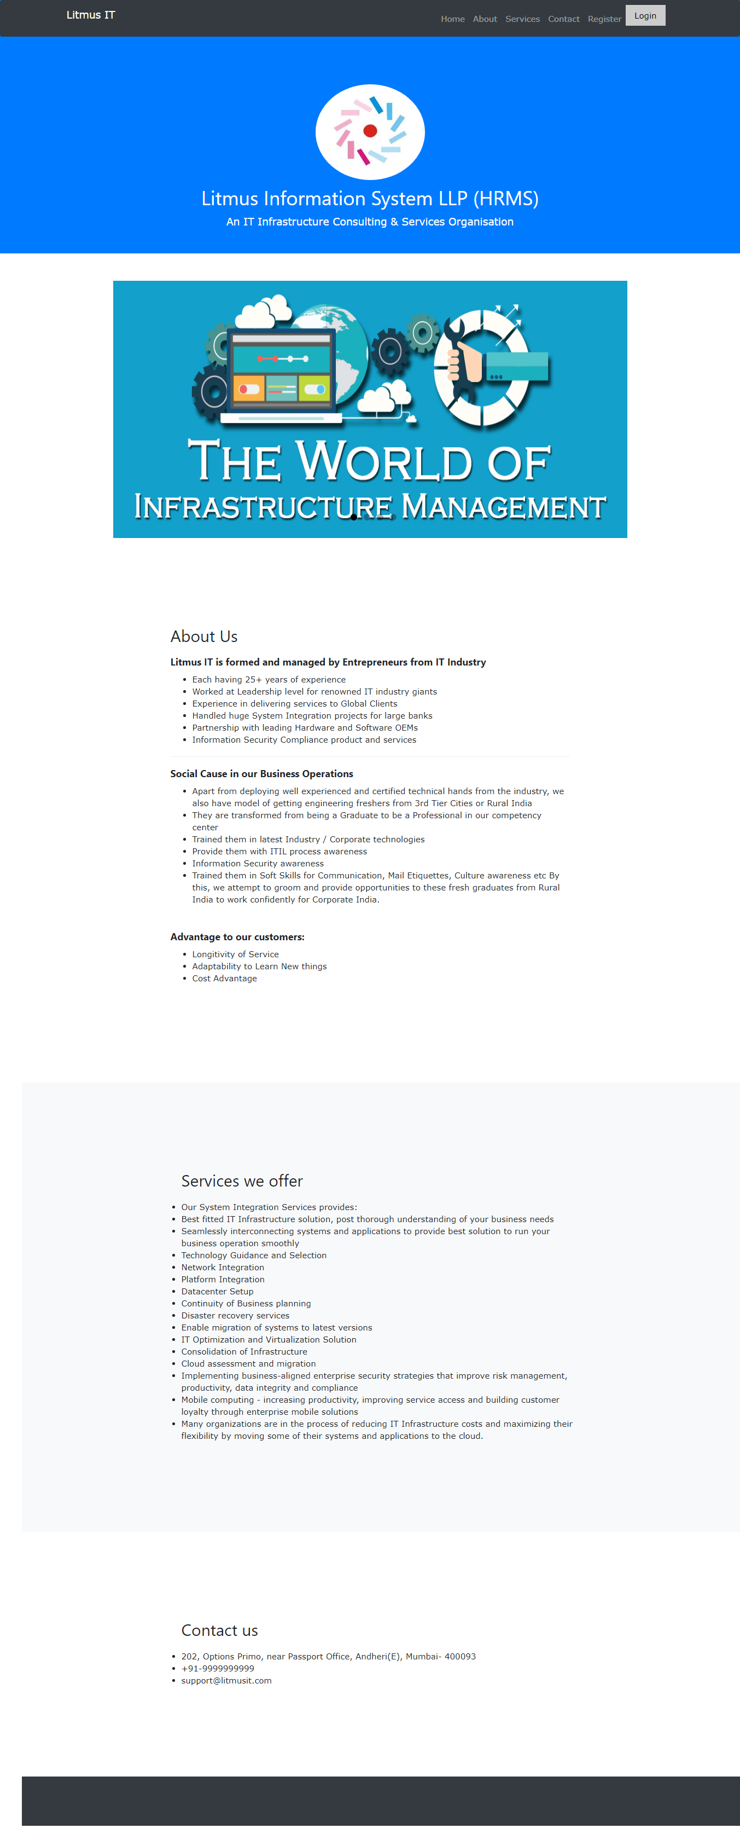
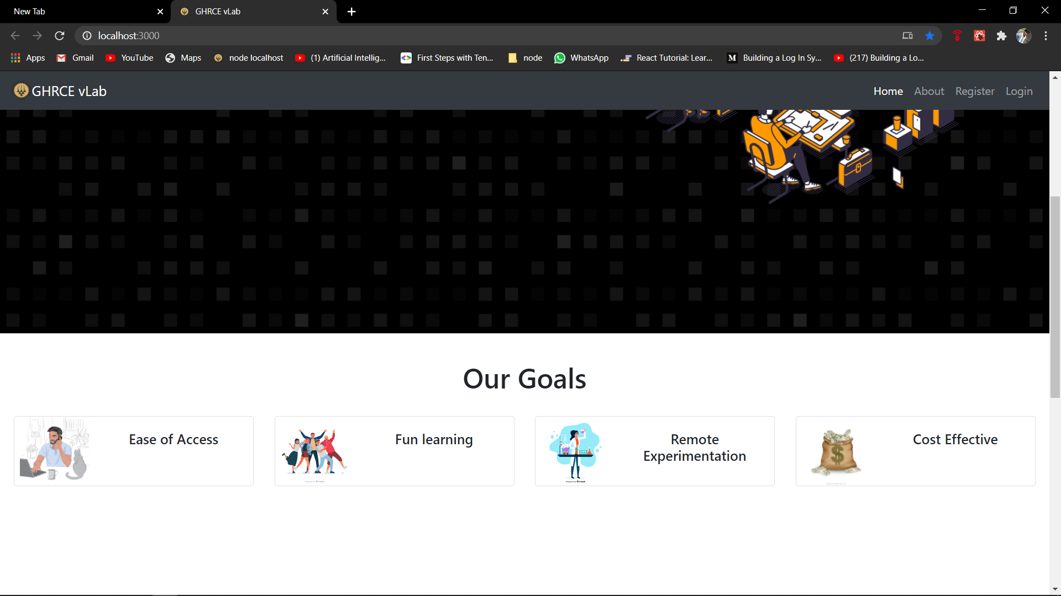
Project Screenshots
The HOME page :
Tabs which included :
Registration Page
Login pages .

Slide 8
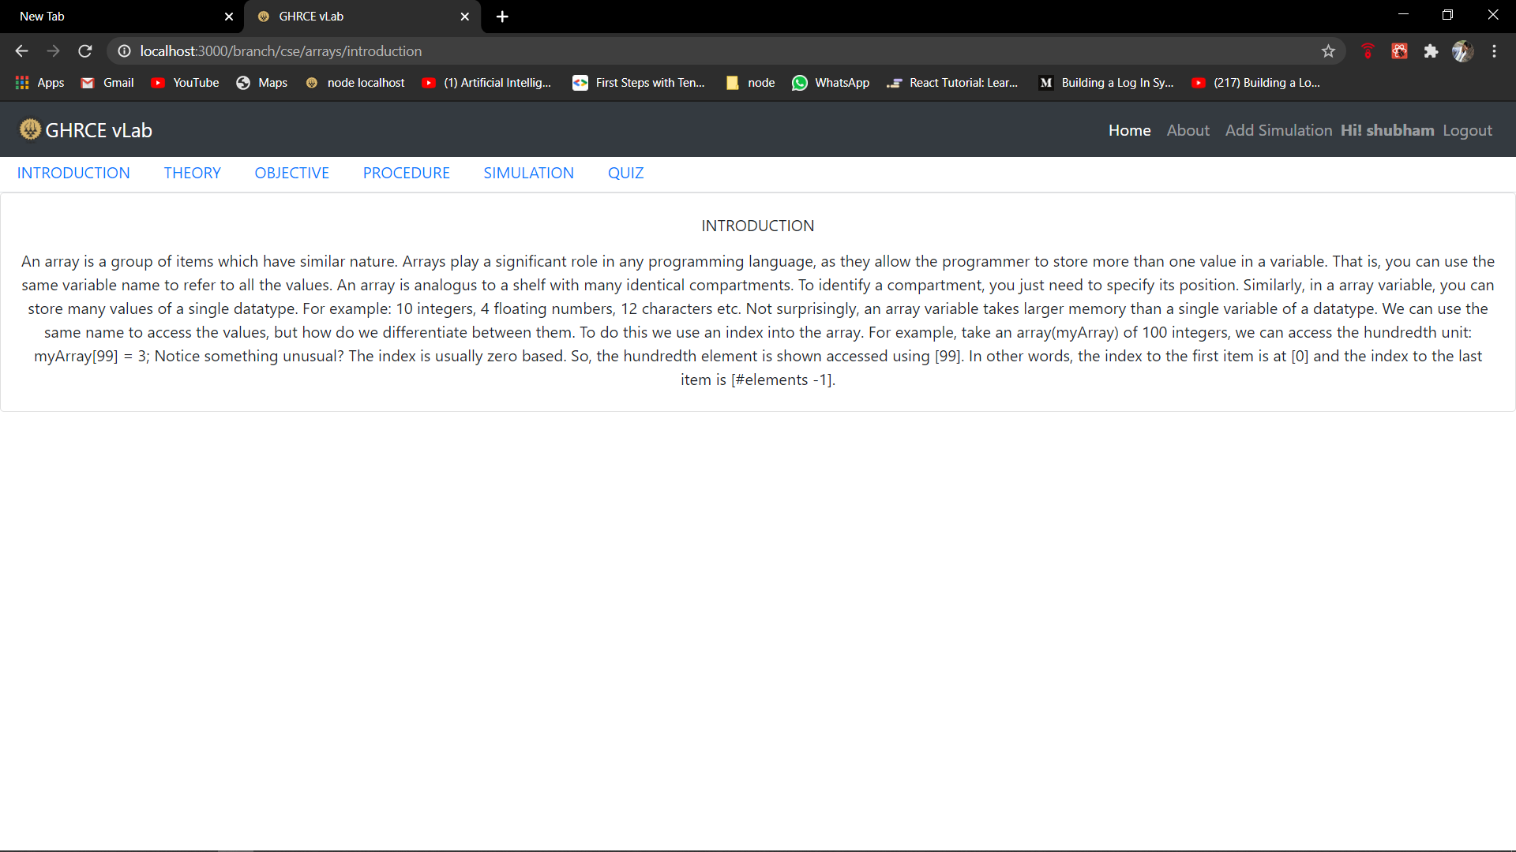
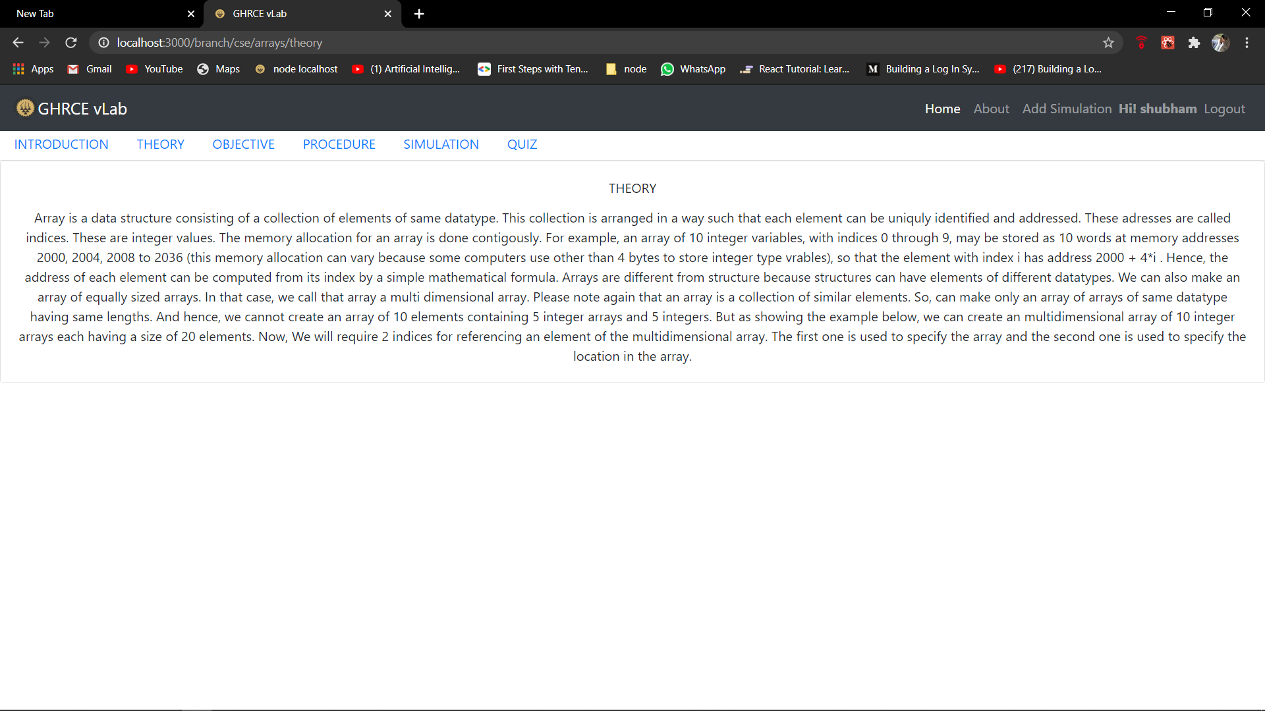
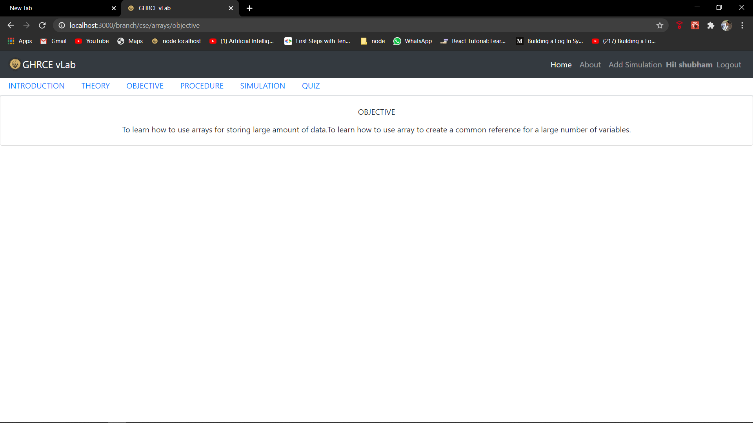
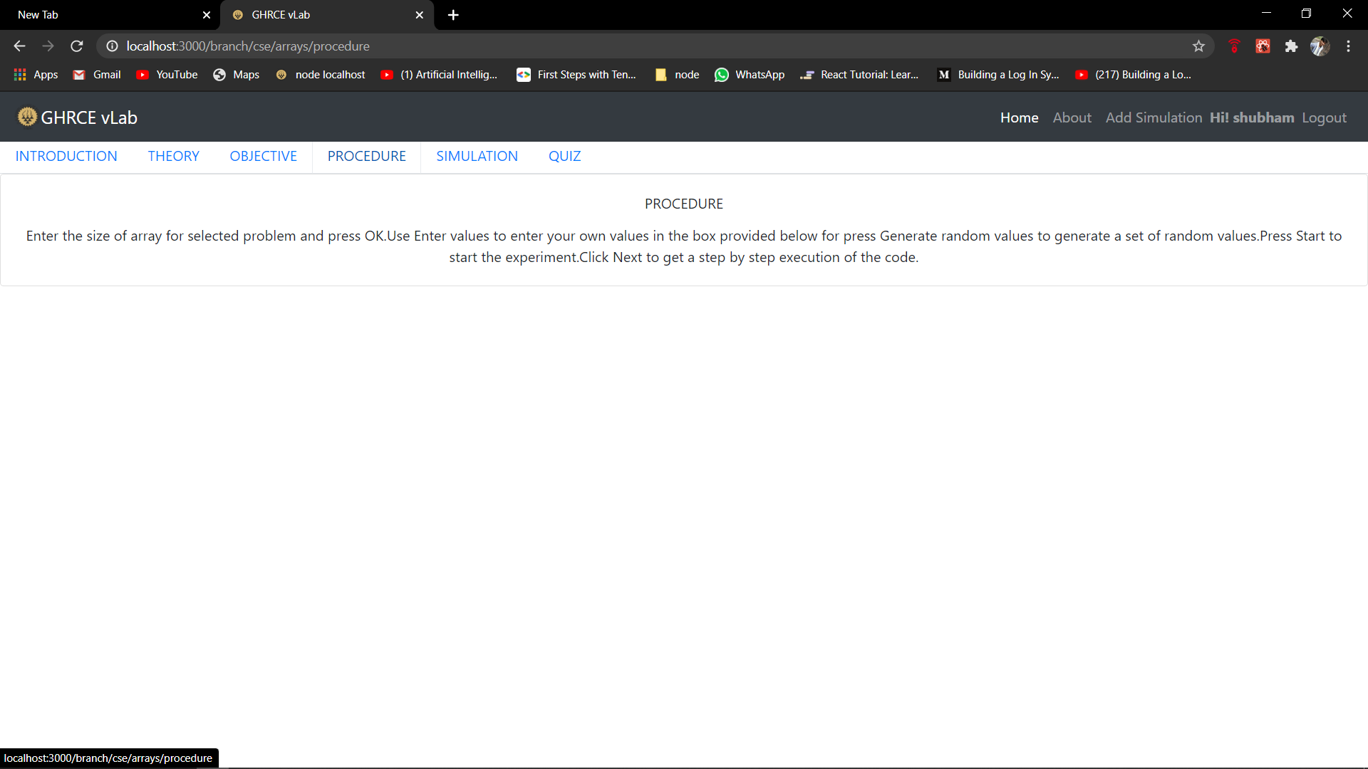
Project Screenshots

Slide 9
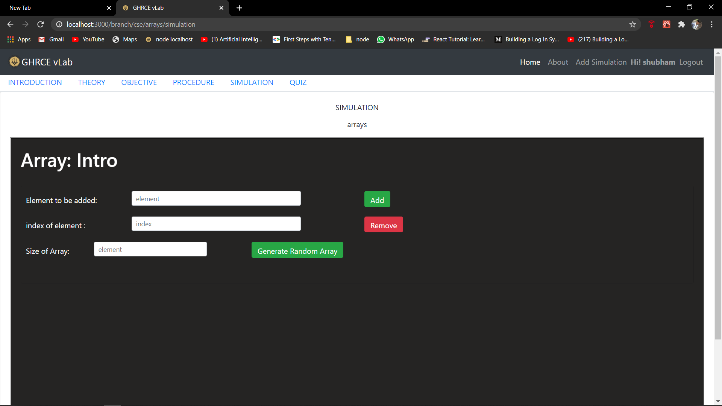
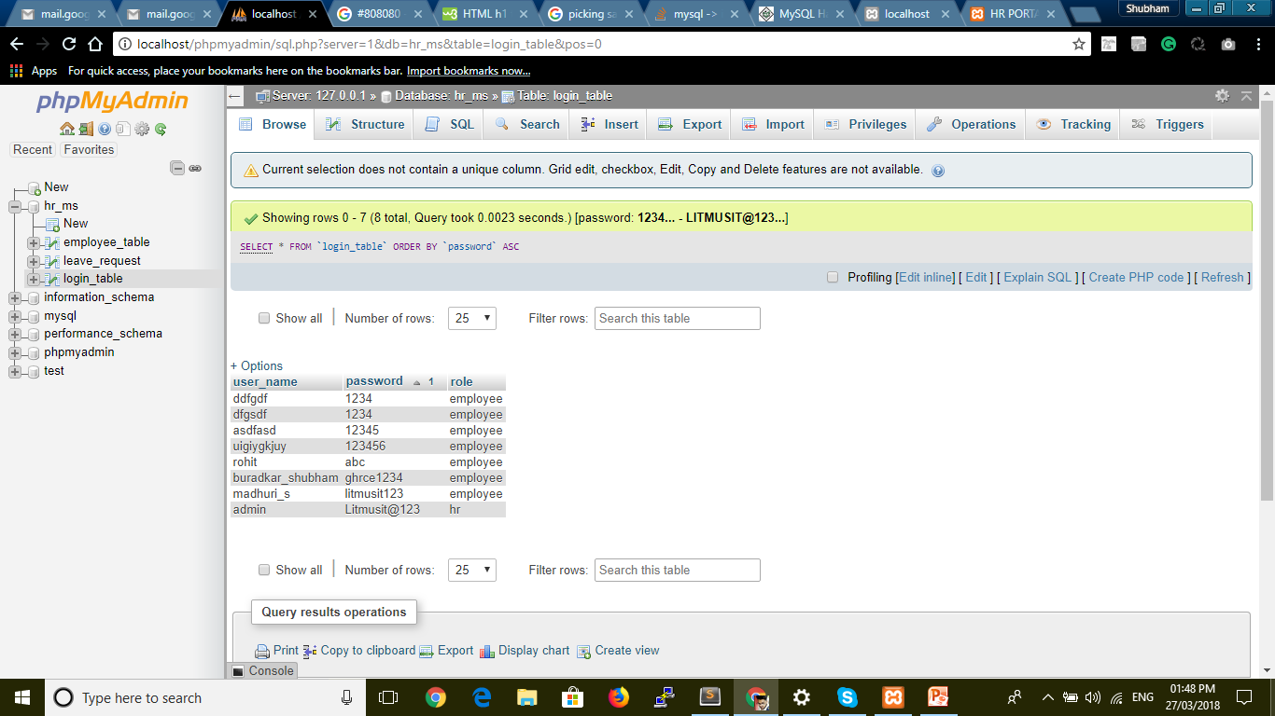
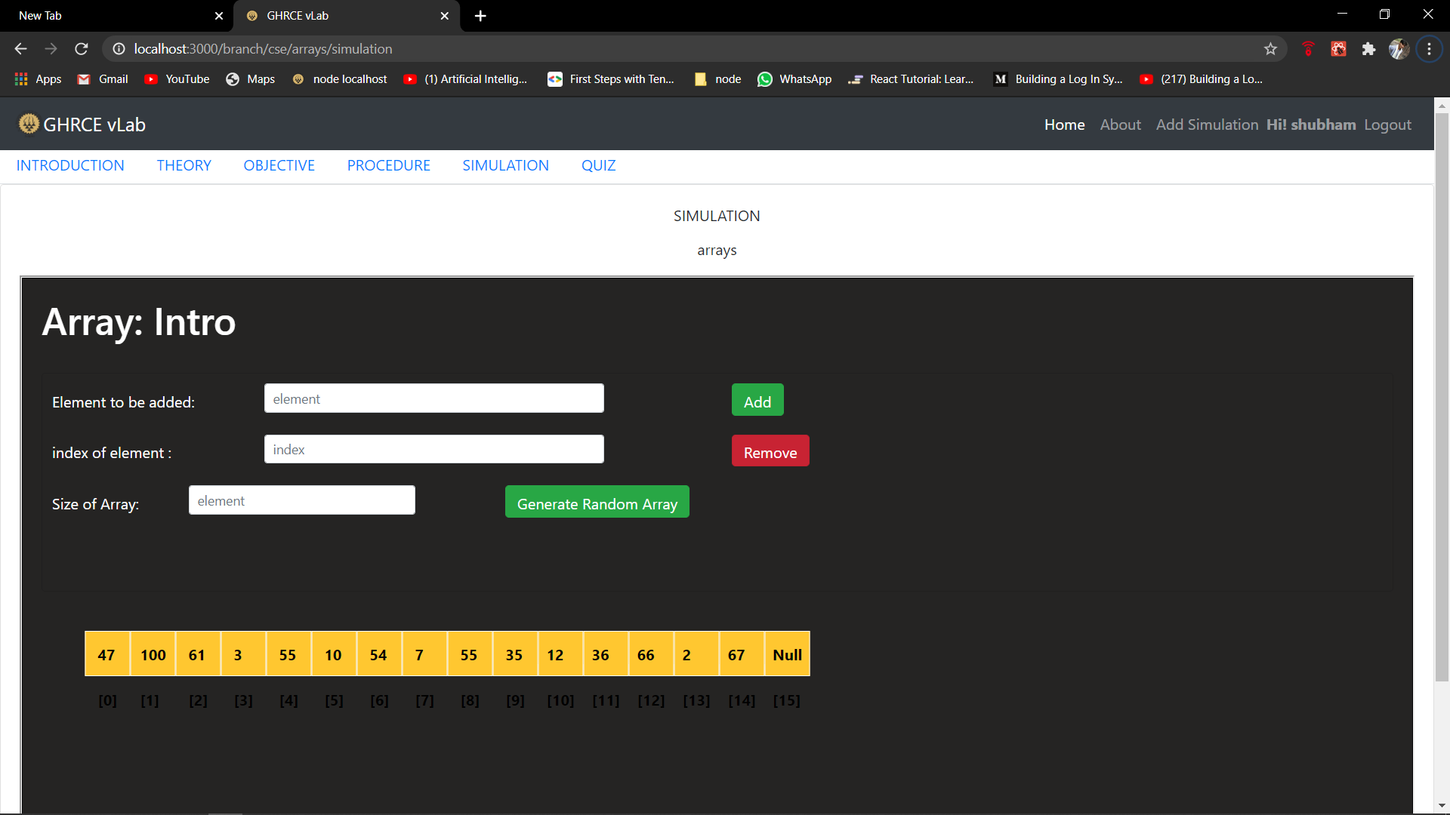
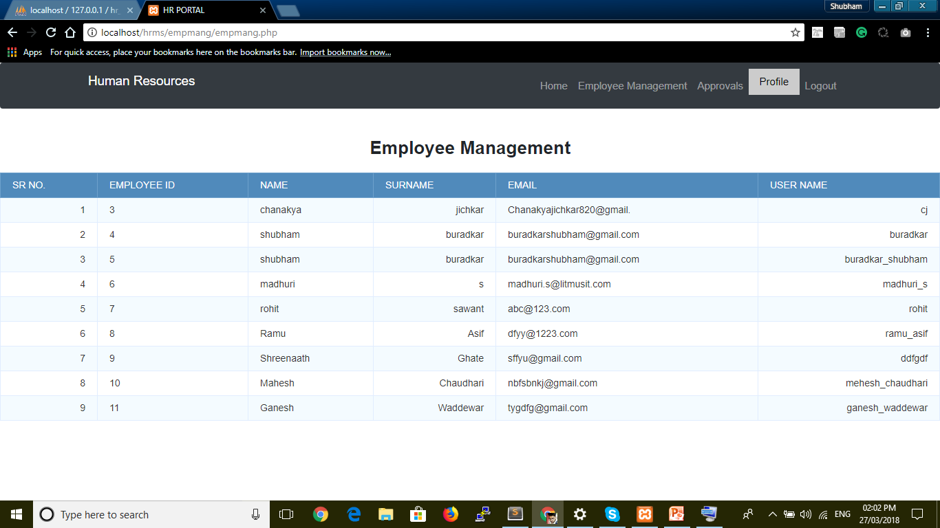
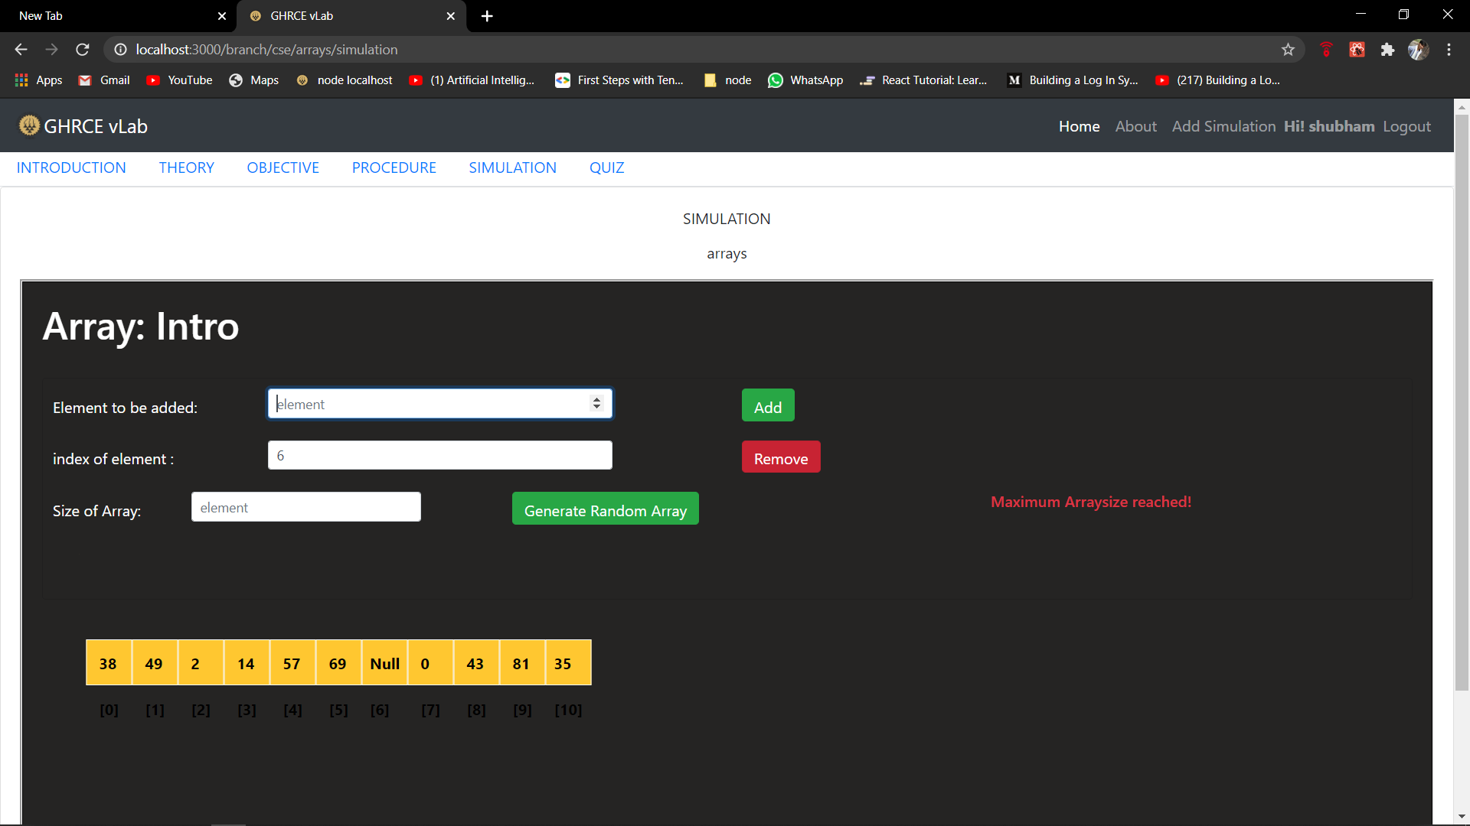
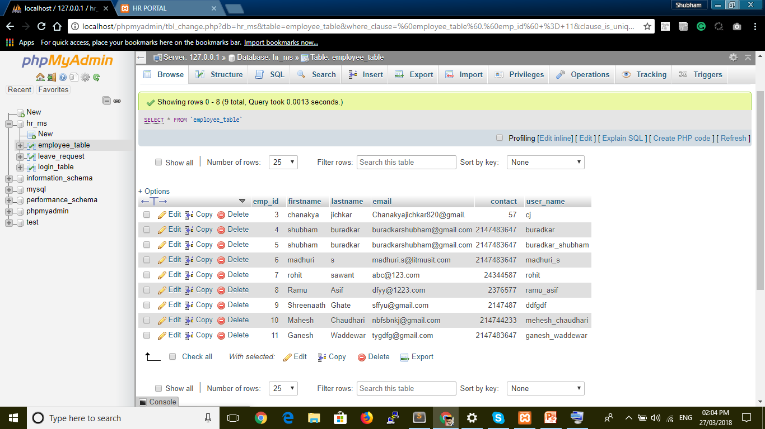
Project Screenshots
Simulation page for this project
Array introducction :
Size of Array :
This page is show maximum Arraysize Reached :

Slide 10
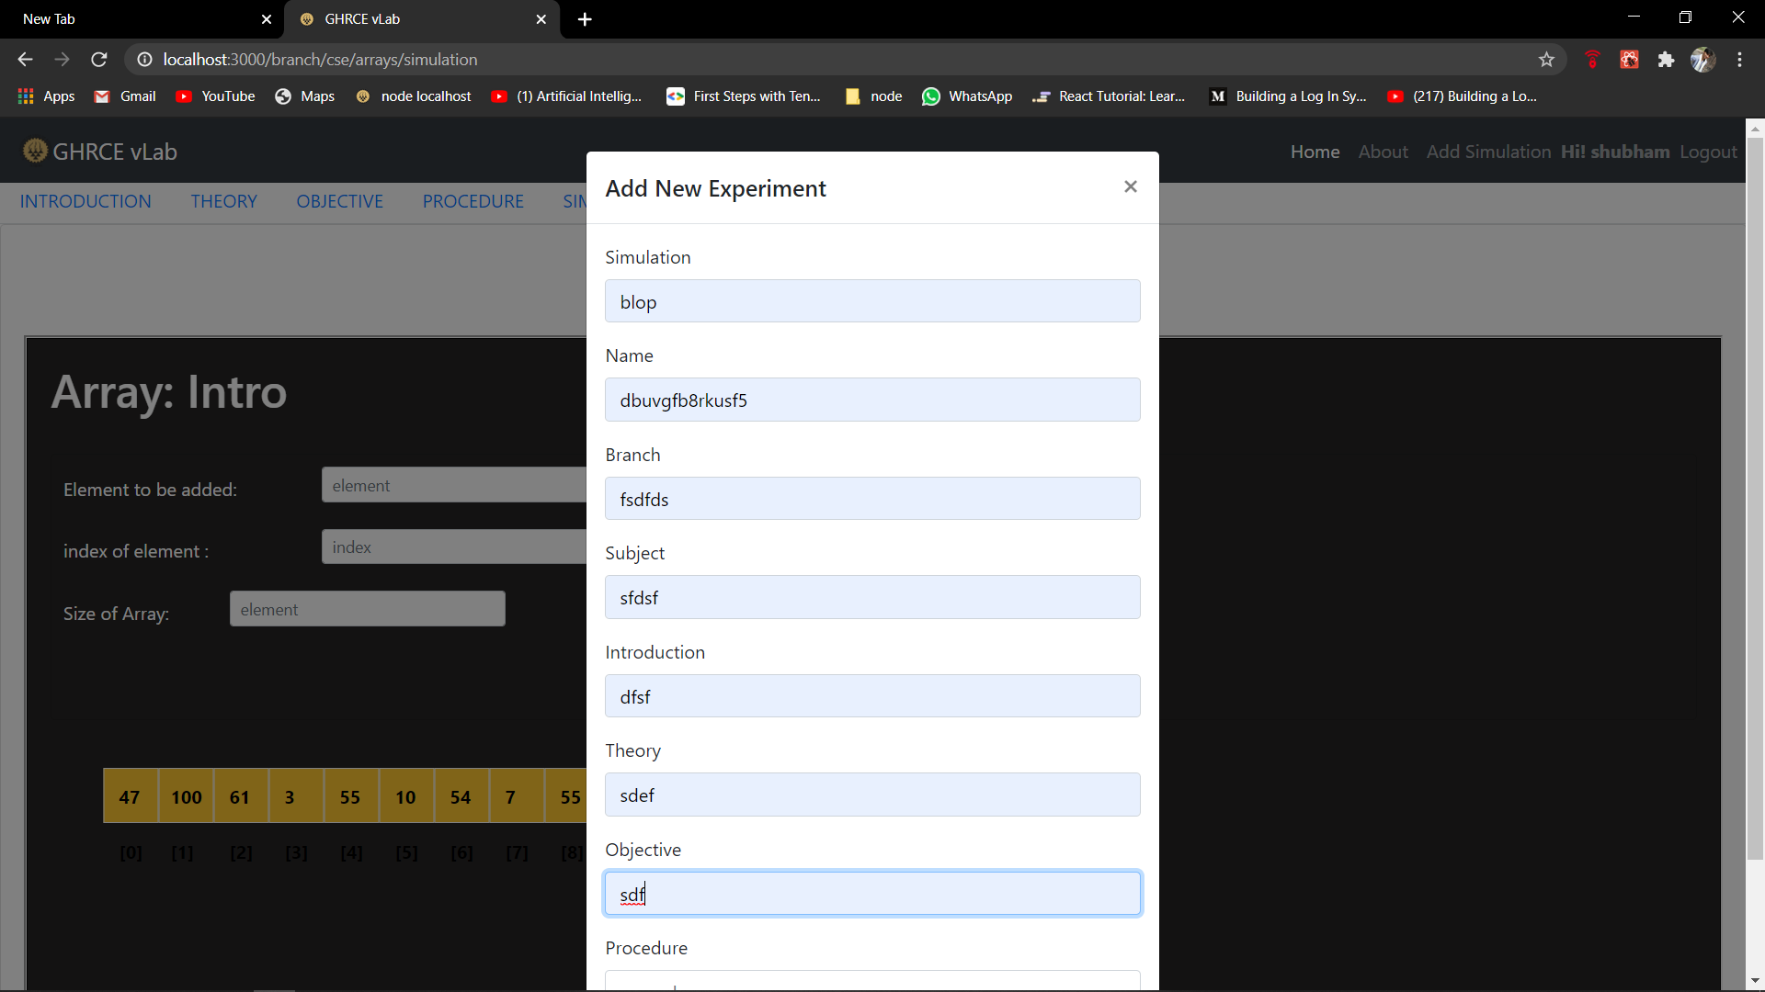
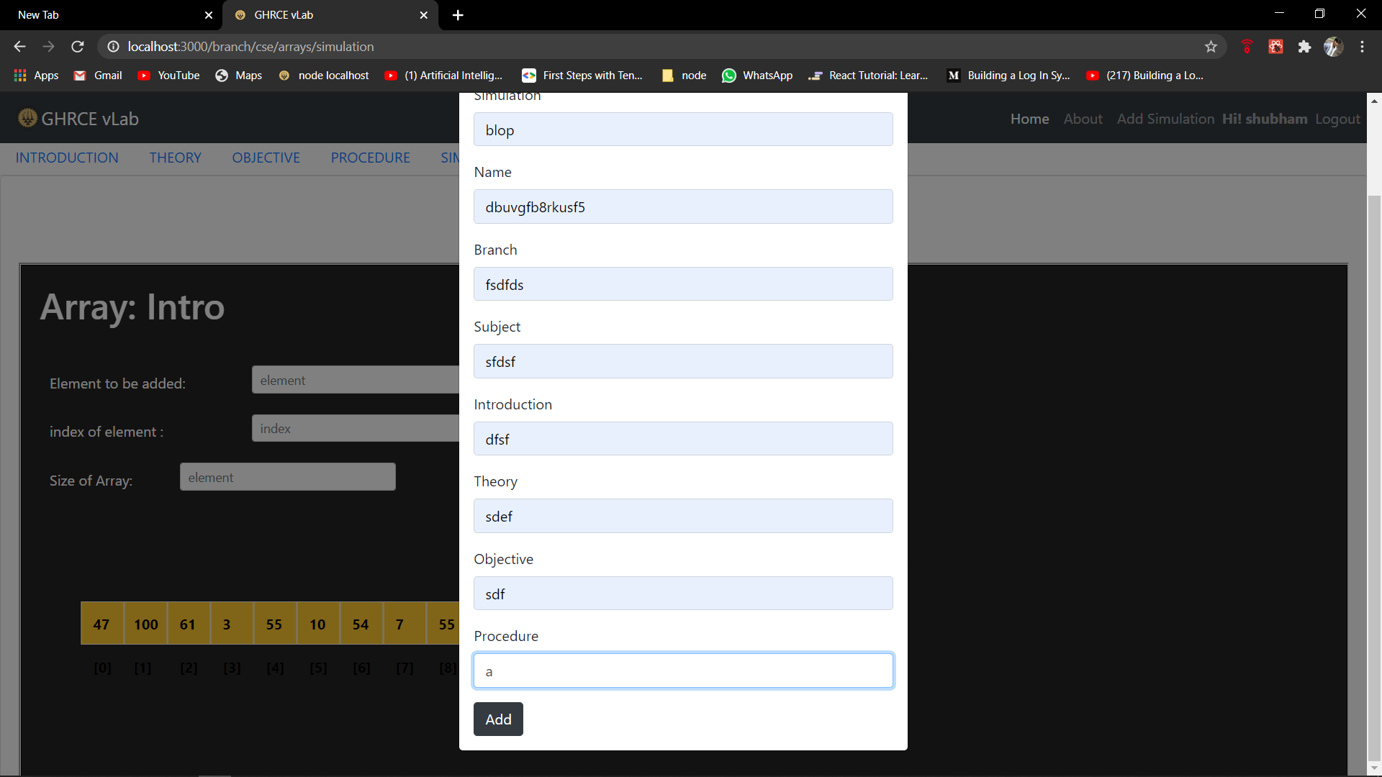
Project screenshots
. Admin page only for add new Experiment . Experiment Extended

Slide 11
References
Survey paper on Virtual Lab for E- Learners by International Journal of Application or Innovation in Engineering & Management (IJAIEM)
http://www.vlab.co.in/
https://www.cs.usfca.edu/
http://vlabs.iitb.ac.in/vlab/labscse.html
https://html-iitd.vlabs.ac.in/

Slide 12
Thank You…..

